Slide 1
Olympic Games
Milestone 4: Storytelling

Slide 2

Objective
Gaining some insight about the Olympic games.

Slide 3
Audience
Journalists, coaches, countries (government) who are looking to understand the Olympic Games results. Journalists in order to publish the information. Coaches and government to improve the results of their team / country.

Slide 4
Questions
What has been the demographics of Olympics – what age group, gender(sex) and countries have more participants and better results?
Which country has been more regular in Olympics, who has been winning more medals? Which sports in which season Olympics is popular amongst the top countries?
What effect does the host country have in the medals won at the Olympics?

Slide 5
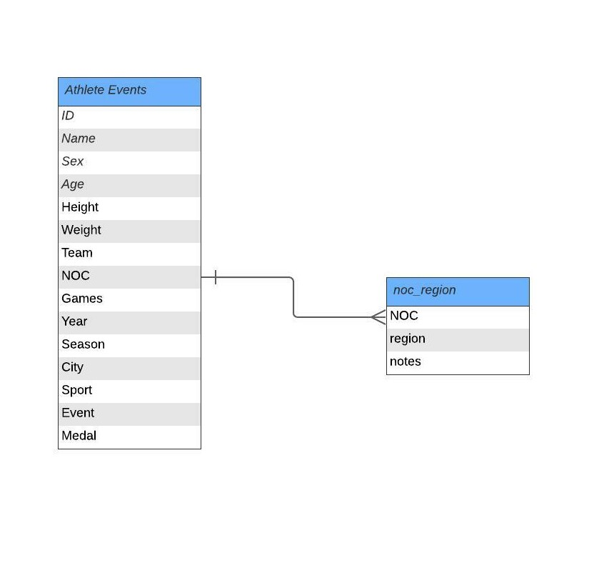
ER DIAGRAM
Data Base
120 years of Olympic history:
Athlete and Results

Slide 6
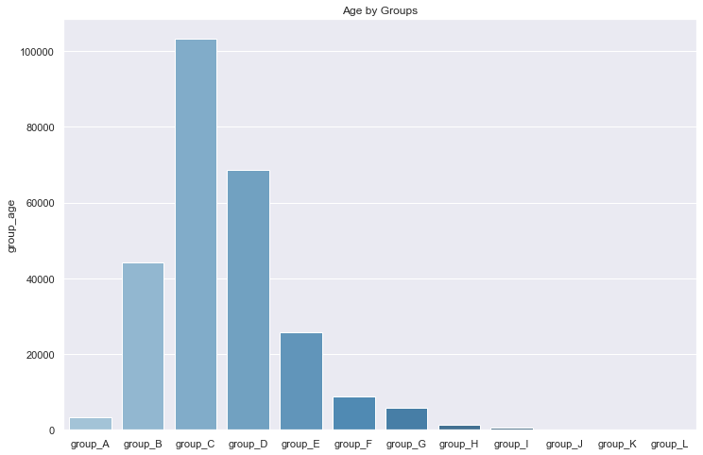
Demographics of Olympics
What has been the demographics of Olympics – what age group, gender (sex) and countries have more participants and better results?
The age group B between 20 and 25 is the most represented.
Average: 25.5 years old.
Minimum: 10 years old
Name: Dimitrios Loundras(Greece)
Sport: Gymnastics
Game: 1896 Summer
Maximum: 97 years old
Name: John Quincy Adams Ward(USA)
Sport: Art Competitions
Games: 1928 Summer

Slide 7
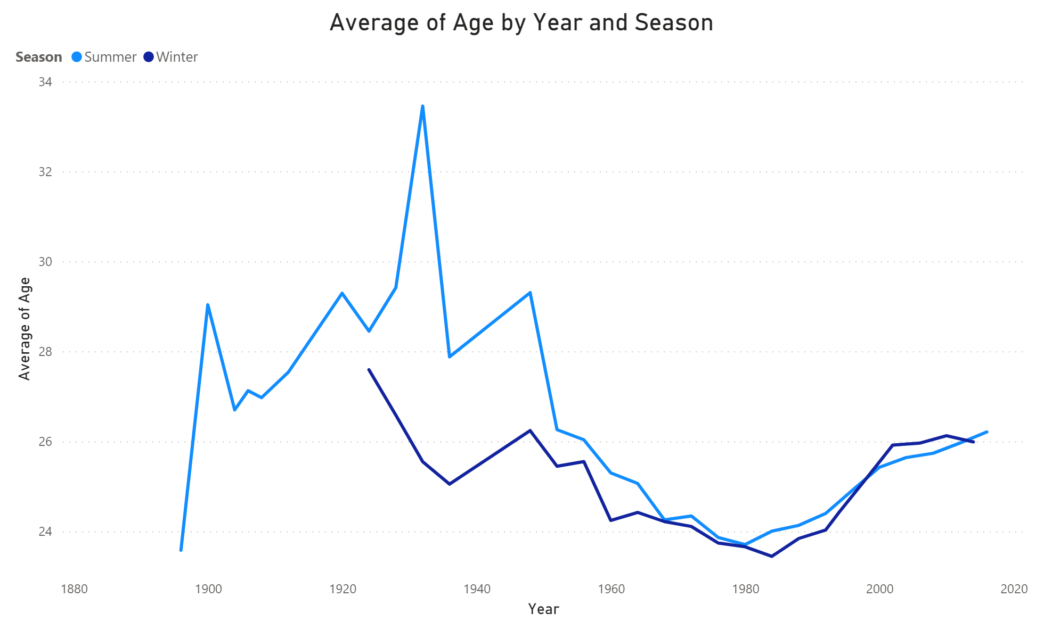
Demographics of Olympics
The age of the participants decreased until 1980 (Summer Games) and 1984 (winter Games) and then increased.
Despite the increase registered in the last Olympics (since 1980), the average age in the last years has never exceeded 26.5 years

Slide 8
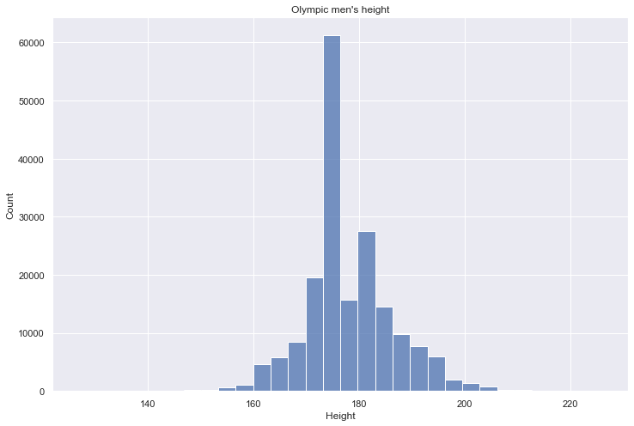
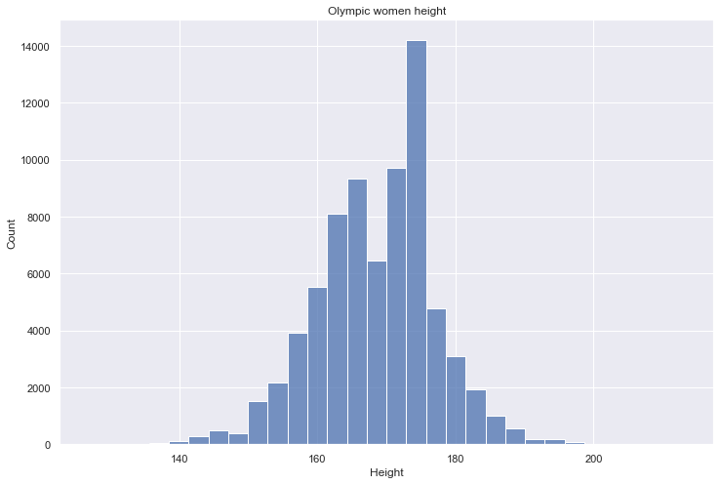
Demographics of Olympics
Male(cm) – Average: - 177, Min: - 127, Max: - 226, Standard Deviation 8.33.
Female(cm) – Average: - 169, Min: - 127, Max:- 213, Standard Deviation 8.5.

Slide 9
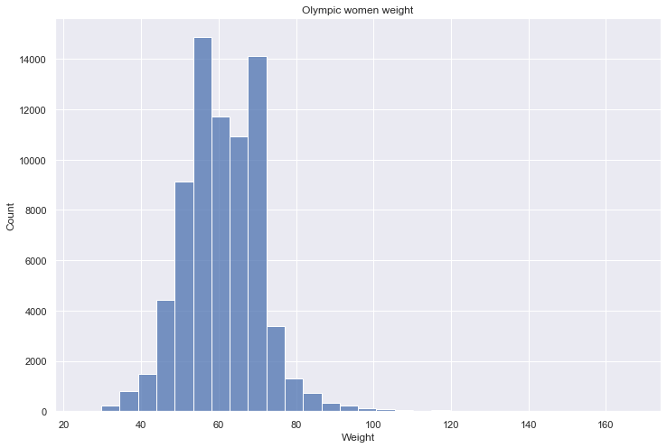
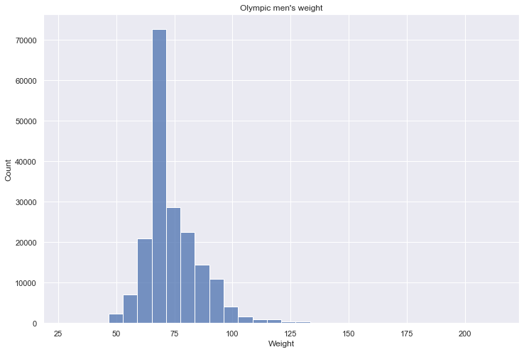
Demographics of Olympics
Male(Kg) – Average: - 74, Min: - 28, Max: - 214, Standard Deviation 11.71.
Female(Kg) – Average: - 61, Min: - 25, Max:- 167, Standard Deviation 10.14.

Slide 10
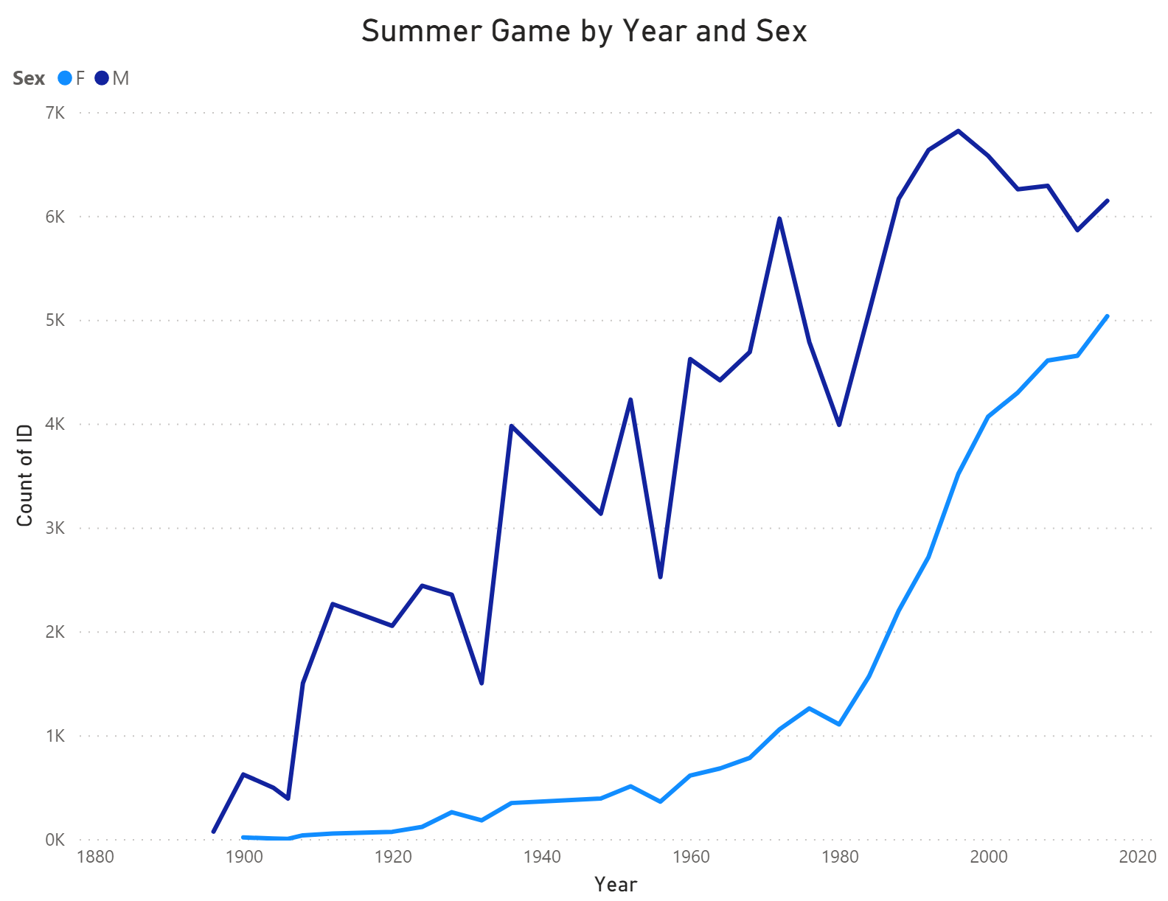
Demographics of Olympics
The number of participants in Summer Olympics has increased over time.
The gap between male and female participation in Summer Games is getting smaller in recent years.

Slide 11
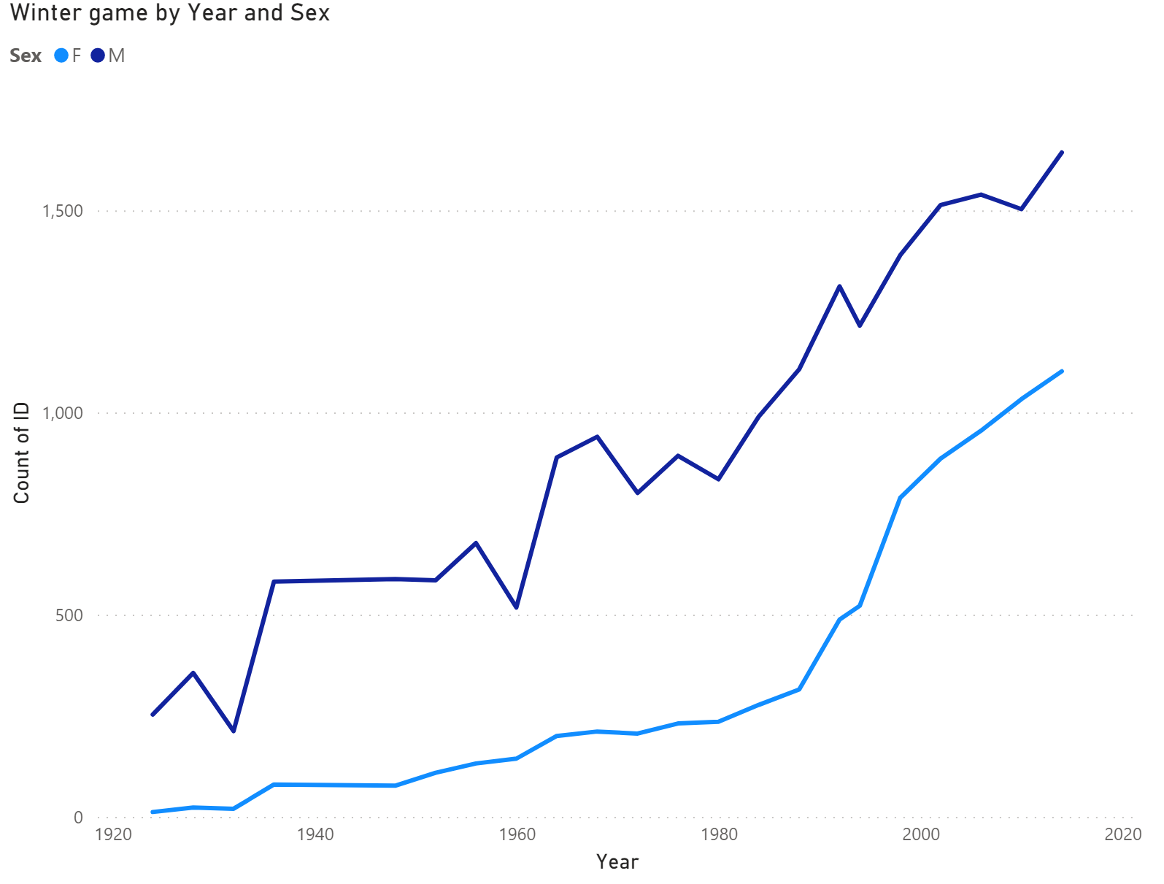
Demographics of Olympics
The number of participants in Winter Olympics has increased over time.
Contrary to what was registered in the Summer Games, the gap between male and female participation tend to remain constant over the years.

Slide 12
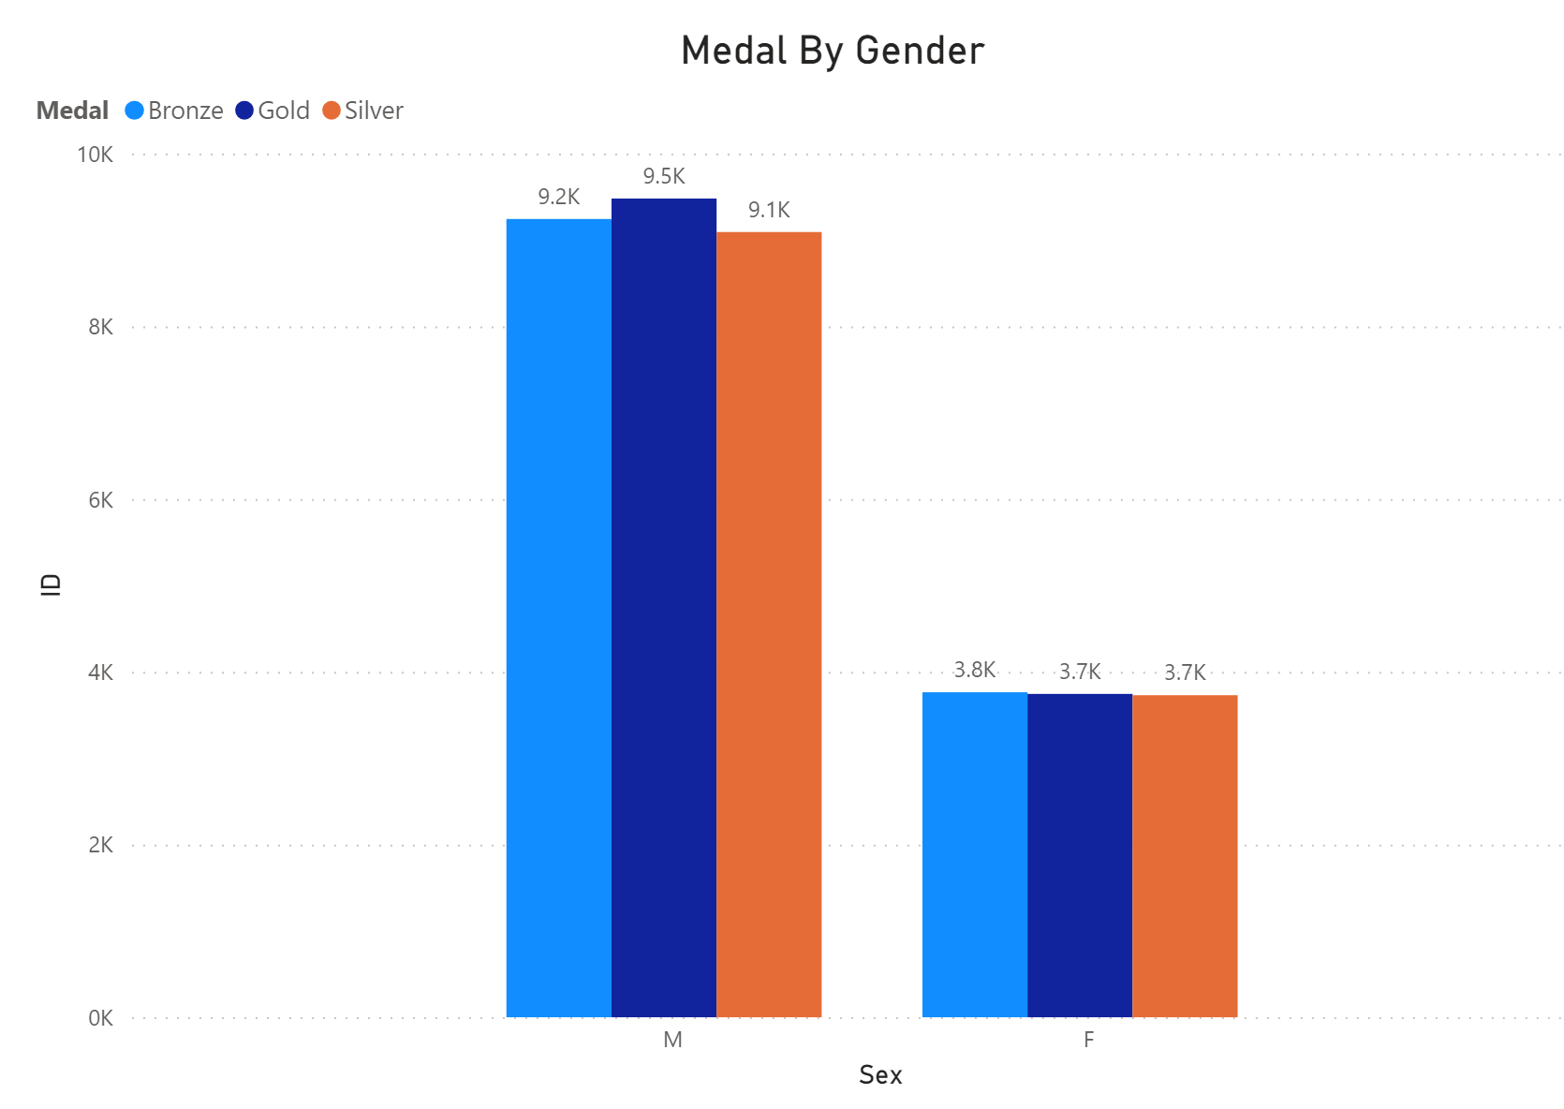
Demographics of Olympics
Men participate more in Olympic Games, so as expected they get more medals.
However, the probability of a women who participate in the games win a medal is higher(15.1% for women and 14.6% for men).

Slide 13
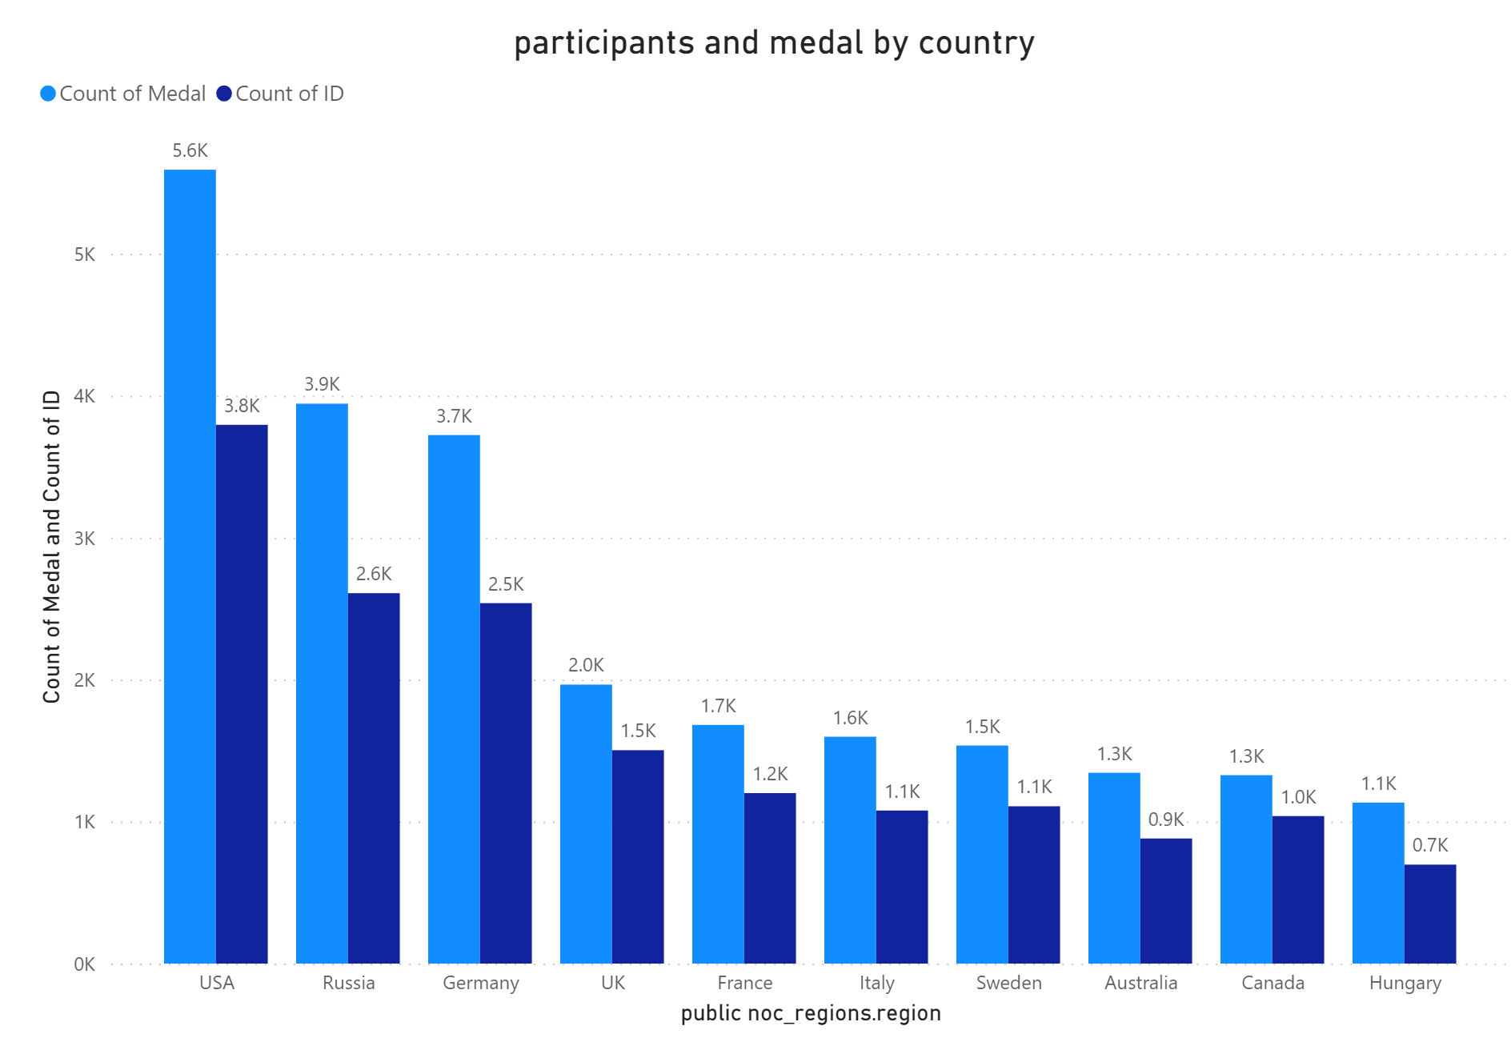
Demographics of Olympics
USA, Russia and Germany are the 3 countries with more medals.
In terms of ratio[number the medals/ number of participants] the winner is Russia (3.947 medals in only 5.610 participants) – 70%.
Among this 10 countries, France is the worst(1.767 medals in 6.170 participants) – 29%

Slide 14
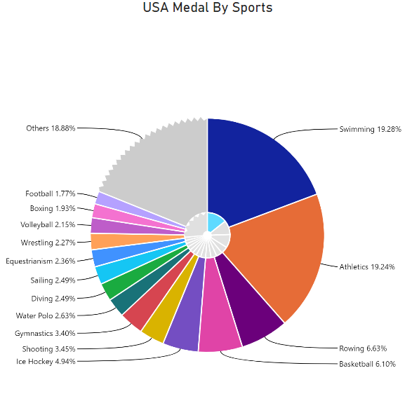
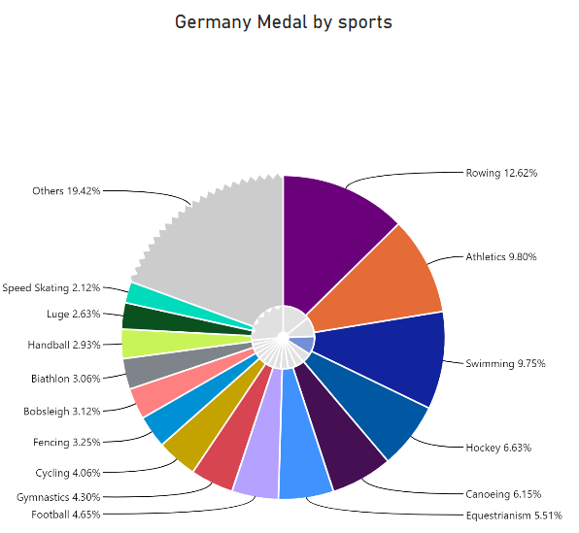
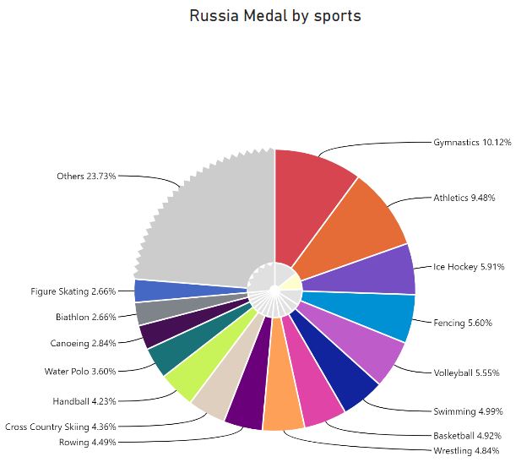

Slide 15
Thank you!

